Slide 1




WAN TECHNOLOGIES
WAN Technologies
Version 3.0
Cisco Regional Networking Academy

Slide 2
Objectives
Examines some of the options available for WAN interconnections, the hardware needed to implement them, and the terminology used to discuss them.

Slide 3
Table of Content
1 | WAN technologies overview
2 | WAN technologies
3 | WAN design

Slide 4

WAN TECHNOLOGIES OVERVIEW

Slide 5
WAN technology
A WAN is a data communications network that operates beyond the geographic scope of a LAN
A company or organization must subscribe to an outside WAN service provider in order to use WAN carrier network services
Notes:
See 2.1.1

Slide 6
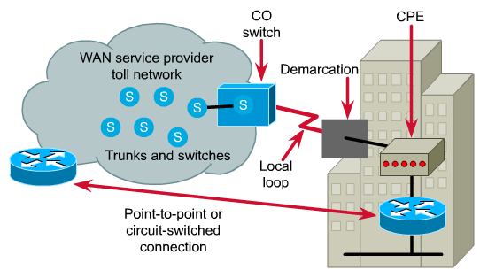
Part of WAN service
Notes:
See 2.1.1
Devices on the subscriber premises are called customer premises equipment (CPE).
A copper or fiber cable connects the CPE to the service provider’s nearest exchange or central office (CO). This cabling is often called the local loop, or "last-mile".

Slide 7
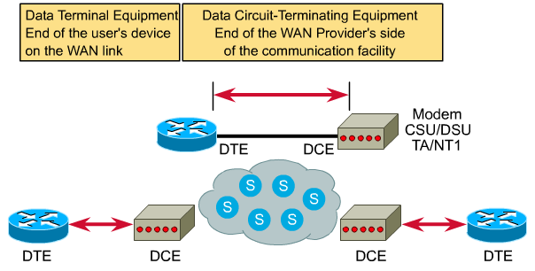
Subscriber to Provider Interface
Notes:
See 2.1.1
In order for the local loop to carry data, a device such as a modem is needed to prepare the data for transmission. Devices that put data on the local loop are called data circuit-terminating equipment, or data communications equipment (DCE). The customer devices that pass the data to the DCE are called data terminal equipment (DTE). The DCE primarily provides an interface for the DTE into the communication link on the WAN cloud. The DTE/DCE interface uses various physical layer protocols, such as High-Speed Serial Interface (HSSI) and V.35. These protocols establish the codes and electrical parameters the devices use to communicate with each other.

Slide 8
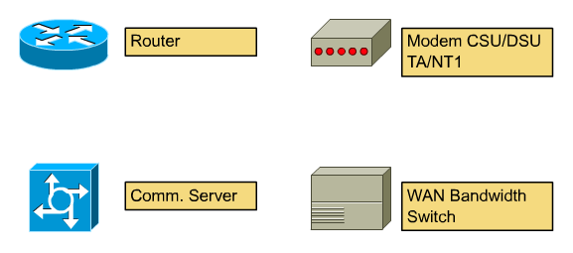
WAN Devices
Notes:
See 2.1.2
A router that contains both LAN and WAN interfaces. The router will use the Layer 3 address information to deliver the data on the appropriate WAN interface.
The communications link needs signals in an appropriate format. For digital lines, a channel service unit (CSU) and a data service unit (DSU) are required. The two are often combined into a single piece of equipment, called the CSU/DSU. The CSU/DSU may also be built into the interface card in the router.
A modem is needed if the local loop is analog rather than digital. Modems transmit data over voice-grade telephone lines by modulating and demodulating the signal.
Older equipment without an ISDN interface requires an ISDN terminal adapter (TA) for ISDN compatibility.
Communication servers concentrate dial-in user communication and remote access to a LAN. They may have a mixture of analog and digital (ISDN) interfaces and support hundreds of simultaneous users.

Slide 9
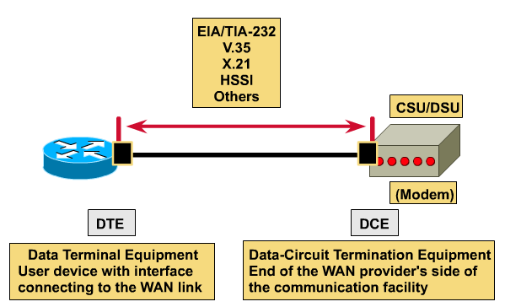
WAN standard: The physical layer
The physical layer protocols describe how to provide electrical, mechanical, operational, and functional connections to the services provided by a communications service provider.
Notes:
See 2.1.2

Slide 10
Physical layer standard
EIA/TIA-232: Up to 64 kbps. ~V.24, RS-232.
EIA/TIA-449: Up to 2 Mbps, capable of longer cable runs.
EIA/TIA-612/613: HSSI, Access to services at T3, E3 and SONET STS-1 rates.
V.35: An ITU-T standard, synchronous.
X.21: An ITU-T standard, synchronous.
G.703: An ITU-T specification, operating at E1 data rates.

Slide 11
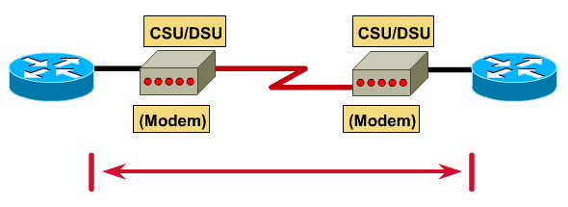
Datalink Layer
The data link layer protocols define how data is encapsulated for transmission to remote sites, and the mechanisms for transferring the resulting frames.
Notes:
See 2.1.3

Slide 12
Data link layer: WAN protocols
Frame Relay: Transmit data very rapidly compared to the other WAN protocols.
PPP: Described by RFC 1661, PPP was developed by the IETF.
ISDN: Digital services that transmits voice and data over existing phone lines.
LAPB: LAPB provides reliability and flow control on a point-to-point basis.
HDLC: An ISO standard, HDLC might not be compatible between different vendors.
Notes:
See 2.1.3

Slide 13
WAN encapsulation
Flag | Header | Data | FCS | Flag
Address | Control | Protocol
Notes:
See 2.1.4
The choice of encapsulation protocols depends on the WAN technology and the equipment. Most framing is based on the HDLC standard
The frame always starts and ends with an 8-bit flag field, the bit pattern 01111110
The address field is not needed for WAN links, which are almost always point-to-point. The address field is still present and may be one or two bytes long. The control field indicates the frame type, which may be information, supervisory, or unnumbered:
Unnumbered frames carry line setup messages.
Information frames carry network layer data.
Supervisory frames control the flow of information frames and request data retransmission in the event of an error.
The control field is normally one byte, but will be two bytes for extended sliding windows systems. Together the address and control fields are called the frame header. The encapsulated data follows the control field. Then a frame check sequence (FCS) uses the cyclic redundancy check (CRC) mechanism to establish a two or four byte field.

Slide 14
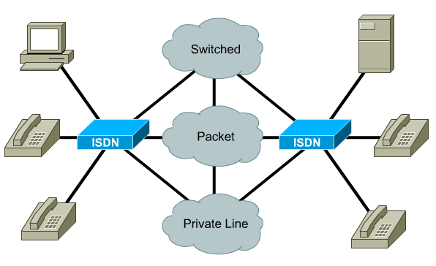
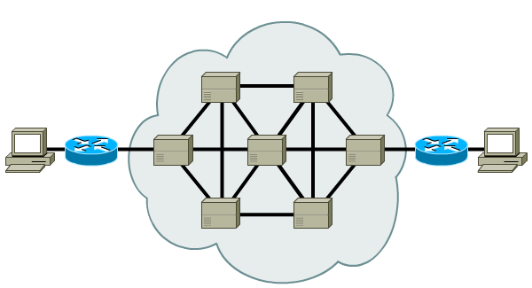
Packet and circuit switching
Notes:
See 2.1.5

Slide 15
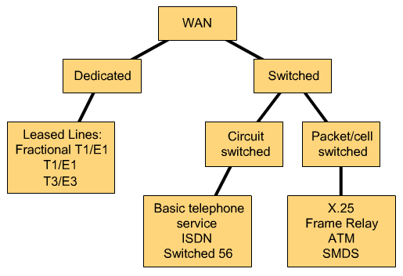
WAN Link options
Notes:
See 2.1.6

Slide 16

WAN TECHNOLOGIES

Slide 17
Analog dialup
Notes:
See 2.2.1
When intermittent, low-volume data transfers are needed, modems and analog dialed telephone lines provide low capacity and dedicated switched connections
The physical characteristics of the local loop and its connection to the PSTN limit the rate of the signal. The upper limit is around 33 kbps. The rate can be increased to around 56 kbps if the signal is coming directly through a digital connection
The advantages of modem and analog lines are simplicity, availability, and low implementation cost. The disadvantages are the low data rates and a relatively long connection time. The dedicated circuit provided by dialup will have little delay or jitter for point-to-point traffic, but voice or video traffic will not operate adequately at relatively low bit rates.

Slide 18
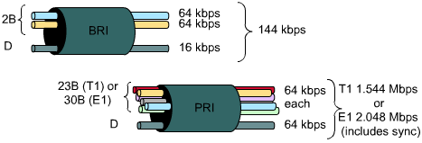
ISDN
Notes:
See 2.2.2
Integrated Services Digital Network (ISDN) turns the local loop into a TDM digital connection. The connection uses 64 kbps bearer channels (B) for carrying voice or data and a signaling, delta channel (D) for call set-up and other purposes
For small WANs, the BRI ISDN can provide an ideal connection mechanism. BRI has a call setup time that is less than a second, and its 64 kbps B channel provide greater capacity than an analog modem link. If greater capacity is required, a second B channel can be activated to provide a total of 128 kbps.
Basic Rate Interface (BRI) ISDN is intended for the home and small enterprise and provides two 64 kbps B channels and a 16 kbps D channel. For larger installations, Primary Rate Interface (PRI) ISDN is available
ISDN is also used as a backup in the case of a failure of the leased line. ISDN tariffs are based on a per-B channel basis and are similar to those of analog voice connections.

Slide 19
Leased line
CSU/DSU
CSU/DSU
Notes:
See 2.2.3
When permanent dedicated connections are required, leased lines are used with capacities ranging up to 2.5 Gbps.
Point-to-point lines are usually leased from a carrier and are called leased lines. Leased lines are available in different capacities. These dedicated circuits are generally priced based on bandwidth required and distance between the two connected points.
The cost of leased-line solutions can become significant when they are used to connect many sites.

Slide 20
X.25
SVC
CSU/DSU
CSU/DSU
PVC
CSU/DSU
Notes:
See 2.2.4
In response to the expense of leased lines, telecommunications providers introduced packet-switched networks using shared lines to reduce costs. The first of these packet-switched networks was standardized as the X.25 group of protocols. X.25 provides a low bit rate shared variable capacity that may be either switched or permanent
Subscribers connect to the X.25 network with either leased lines or dialup connections.
X.25 can be very cost effective because tariffs are based on the amount of data delivered rather than connection time or distance. Data can be delivered at any rate up to the connection capacity
X.25 technology is no longer widely available as a WAN technology in the US. Frame Relay has replaced X.25 at many service provider locations

Slide 21
Frame Relay
PVC
CSU/DSU
CSU/DSU
Notes:
See 2.2.5
Frame Relay provides permanent shared medium bandwidth connectivity that carries both voice and data traffic. Frame Relay is ideal for connecting enterprise LANs
Frame Relay differs from X.25 in several aspects. Most importantly, it is a much simpler protocol that works at the data link layer rather than the network layer.
Frame Relay implements no error or flow control.

Slide 22
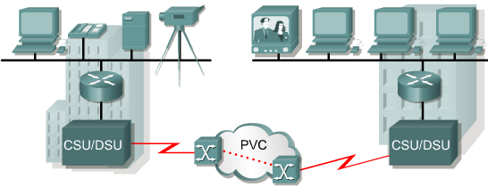
ATM
Notes:
See 2.2.6
Communications providers saw a need for a permanent shared network technology that offered very low latency and jitter at much higher bandwidths. Their solution was Asynchronous Transfer Mode (ATM). ATM has data rates beyond 155 Mbps.
ATM is a technology that is capable of transferring voice, video, and data through private and public networks. It is built on a cell-based architecture rather than on a frame-based architecture. ATM cells are always a fixed length of 53 bytes. The 53 byte ATM cell contains a 5 byte ATM header followed by 48 bytes of ATM payload. Small, fixed-length cells are well suited for carrying voice and video traffic because this traffic is intolerant of delay. Video and voice traffic do not have to wait for a larger data packet to be transmitted.
the ATM cell has at least 5 bytes of overhead for each 48-byte payload. When the cell is carrying segmented network layer packets, the overhead will be higher because the ATM switch must be able to reassemble the packets at the destination. A typical ATM line needs almost 20% greater bandwidth than Frame Relay to carry the same volume of network layer data.

Slide 23
DSL
Service | Download | Upload
ADSL | 1.544-8.192Mbps | 16-640Kbps
SDSL | 1.544-2.048Mbps | 1.544-2.048Mbps
HDSL | 1.544-2.048Mbps | 1.544-2.048Mbps
IDSL | 144Kbps | 144Kbps
RADSL | 64Kbps-8.192Mbps | 16-768Mbps
CDSL | 1Mbps | 16-160Kbps
Notes:
See 2.2.7
Digital Subscriber Line (DSL) technology is a broadband technology that uses existing twisted-pair telephone lines to transport high-bandwidth data to service subscribers. Broadband refers to a technique which uses multiple frequencies within the same physical medium to transmit data
The voice channel of a standard consumer telephone covers the frequency range of 330 Hz to 3.3 KHz. A frequency range, or window, of 4 KHz is regarded as the requirements for any voice transmission on the local loop. DSL technologies place upload (upstream) and download (downstream) data transmissions at frequencies above this 4 KHz window. This technique is what allows both voice and data transmissions to occur simultaneously on a DSL service
DSL services provide capabilities for using Virtual Private Network (VPN) connections to a VPN server, which is typically located at the corporate site.

Slide 24
Cable modem
Enhanced cable modems enable two-way, high-speed data transmissions using the same coaxial lines that transmit cable television
A cable modem is capable of delivering up to 30 to 40 Mbps of data on one 6 MHz cable channel
Notes:
See 2.2.8

Slide 25

WAN DESIGN

Slide 26
Steps in WAN design
LOCATE LANs
ANALYZE TRAFFICS
PLAN TOPOLOGY
Review
PLAN BANDWIDTH
Iterate
CHOOSE TOPOLOGY
COST AND EVALUATE
Notes:
See 2.3.2

Slide 27
How to identify and select networking capabilities
Selecting an interconnection pattern or layout for the links between the various locations
Selecting the technologies for those links to meet the enterprise requirements at an acceptable cost
Notes:
See 2.3.3

Slide 28
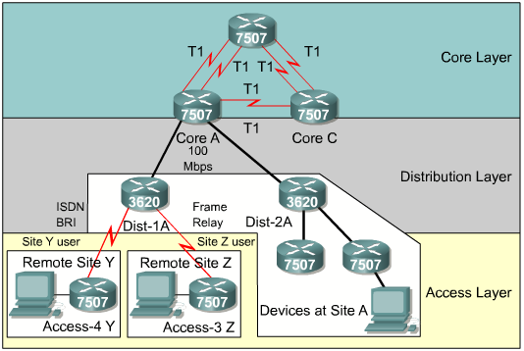
Three-layer design model
Notes:
See 2.3.4, 2.3.5

Slide 29
Other WAN design considerations
Security
Server placement in WANs
Notes:
See 2.3.6

Slide 30

Summary
Familiarity with WAN terminology describing equipment, such as CPE, CO, local loop, DTE, DCE, CSU/DSU, and TA
Familiarity with WAN terminology describing services and standards, such as ISDN, Frame Relay, ATM, T1, HDLC, PPP, POST, BRI, PRI, X.25, and DSL
Elements of WAN design, including upgrading, extending, modifying an existing WAN, and recommending a WAN service to an organization based on its needs

Slide 31

Q&A
Notes:
_________________________________________________________________________
_________________________________________________________________________
_________________________________________________________________________
_________________________________________________________________________
_________________________________________________________________________
_________________________________________________________________________
_________________________________________________________________________
_________________________________________________________________________
_________________________________________________________________________
_________________________________________________________________________
_________________________________________________________________________
_________________________________________________________________________
_________________________________________________________________________
_________________________________________________________________________
_________________________________________________________________________
_________________________________________________________________________
_________________________________________________________________________
_________________________________________________________________________
_________________________________________________________________________

Slide 32
Enjoy the Course
Notes:
_________________________________________________________________________
_________________________________________________________________________
_________________________________________________________________________
_________________________________________________________________________
_________________________________________________________________________
_________________________________________________________________________
_________________________________________________________________________
_________________________________________________________________________
_________________________________________________________________________
_________________________________________________________________________
_________________________________________________________________________
_________________________________________________________________________
_________________________________________________________________________
_________________________________________________________________________
_________________________________________________________________________
_________________________________________________________________________
_________________________________________________________________________
_________________________________________________________________________
_________________________________________________________________________

